Slide 1



Terminations
for
Non-Payroll
2024

Slide 2


Termination Reasons
ABCs can terminate an employee in Edison for any reasons including:
  Death
  Involuntary Termination
  Gross Misconduct
  Resignation

Slide 3


Navigation to Benefits Workcenter
To terminate an employee in Edison, you will need to complete the following steps:
  From the Edison homepage, click on found on the right-hand side of your screen.
  Click Benefits Workcenter. It is located under WorkCenters on the top left-hand side of your screen.

Slide 4
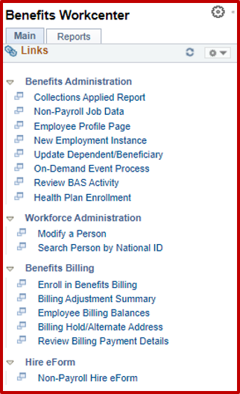

Click Non-Payroll Job Data
Click
Non-Payroll Job Data

Slide 5
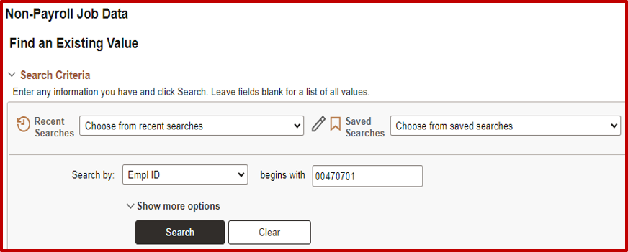
Enter the Employee‘s Edison ID
Enter the Employee’s Edison ID
  Click Search

Slide 6
Terminations: Higher Education
For Higher Education:
The termination date should be entered as the termination date in Edison. Benefits terminate at the end of the month after the employee leaves.
Examples:
  If an employee resigns and terminated in Edison on March 15th, the date of termination that needs to be entered in Edison Job Data is 3/15. Insurance will terminate on April 30th.
  If an employee resigns and terminated in Edison on April 30th, the date of termination that needs to be entered in Edison Job Data is 4/30. Insurance will terminate on 5/31.
  If an employee resigns and terminated in Edison on May 15th, the date of termination that needs to be entered in Edison Job Data is 5/15. Short-term disability will end on 5/15 and all other benefits will end on 6/30.

Slide 7

Terminations: Local Ed & Local Gov
For Local Education & Local Government:
When an employee terminates, ABCs can enter either the coverage end date or the
last day of the month prior to when they want the coverage to end.
  In both cases, the other box will populate the corresponding termination date to match their entry.
  Benefits always terminate at the end of the month.
  The main point to ask is when the agency wants the benefits to end for the employee.
Department of
Finance &
Administration

Slide 8
Terminations: Local Ed & Local Gov
Examples:
  If an employee resigns on April 30th, the employee paid the premium and the insurance terminates on 4/30/2024, the effective date to be entered would be 3/31/2024.
  If an employee resigns on May 11th, the employee paid the premium and the agency wants benefits to terminate at the end of June, the date of termination in Edison would be 5/31.
  If an employee resigns on May 11th, the employee paid the premiums and the agency wants benefits to terminate at the end of July, the date of termination in Edison would be 6/30.

Slide 9
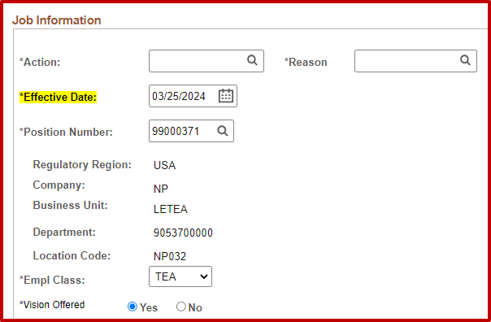
Select Action Code
Click on the magnifying glass to retrieve the action code for termination.

Slide 10
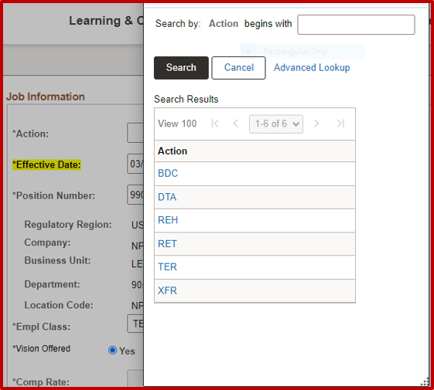
Selecting TER for Termination
Select TER for termination

Slide 11
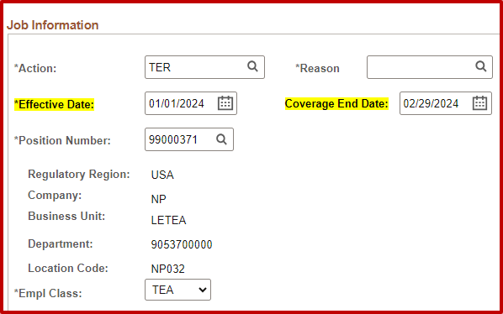
Job Information: Screenshot

Slide 12

Reason for Termination
Click on the magnifying glass to retrieve the Reason for termination.

Slide 13
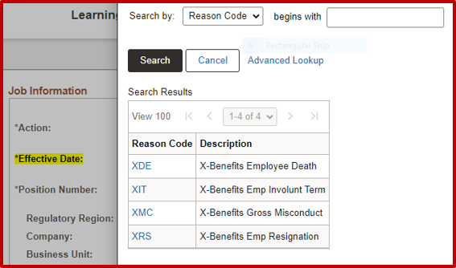

Select the Applicable Reason
Select the applicable reason:
  X-Benefits Employee Death
  X-Benefits Employee Involuntary term
  X-Benefits Gross Misconduct
  X-Benefits Emp Resignation
Note: If you select gross misconduct, the employee will NOT be eligible to receive benefits through COBRA.

Slide 14
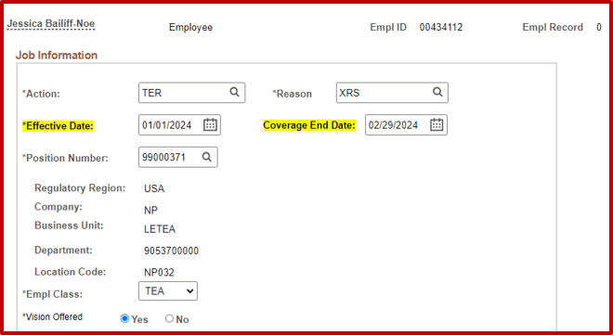

Effective Date
Enter the effective date: This will be the last day of the month prior to benefits ending.
Example:
Effective date: 3/31/2024
Coverage end date: 4/30/2024
Note: Benefits are ALWAYS terminated at the end of the month.

Slide 15
Effective Date and Coverage End Date
Select Effective Date or Coverage End Date. The other field will populate the corresponding date to ensure the date is entered correctly.
Example:
If you enter 3/31/2024 in the effective field, the coverage end date field will show 4/30/2024 or vice versa.
Note: Benefits are ALWAYS terminated at the end of the month.

Slide 16
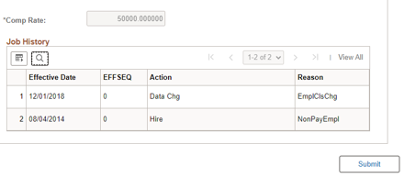
Finalize and Submit
  To finalize, scroll to the bottom of the page.
  Click submit.
  You will receive a message stating the termination was successful.

Slide 17

Terminating an Employee Before the Insurance Coverage Begin Date:
There will be instances in which an employee may end employment before the insurance coverage begins. When this type of termination occurs, Agency Benefits Coordinator’s cannot enter the termination into the system.

Slide 18

Terminating an Employee Before the Insurance Coverage Begin Date:
Benefits Administration will have to enter this type of termination manually. Agency Benefits Coordinator will need to notify Benefits Administration either by Zendesk or utilizing a Corrections and Clarifications form, requesting the termination to be keyed as the agency cannot process this termination type.

Slide 19

Reminders
  You are not required to upload any documentation for the termination of an employee. The employee’s benefits will automatically terminate in Edison.
  For ABCs that terminate employment, you are unable to enter your own termination in Edison. In this instance, the backup ABC MUST enter the termination in Edison. If your agency doesn’t have a Backup ABC, a request can be submitted to Benefits Administration through Zendesk. You will request that BA enters the termination.

Slide 20

Reminders
  If you use the reason code of XMC Gross Misconduct, the employee will not be eligible for Cobra.
  You can enter terminations with a future date.
  If you enter a termination in error, submit a Corrections and Clarification Form requesting BA to correct the termination date in Edison.

Slide 21
Reminders
How long will my state-sponsored insurance be active after my termination date?
  For Local Education Employees:
The last day of the month for which your last contribution was applied.
  For Local Government Employees:
The last day of the month for which your last contribution was applied.
  For Higher Education Employees:
The last day of the month for which your last contribution was applied.

Slide 22

Retros
Agencies that fail to report employment terminations are limited to a three-month refund from the time of notification to Benefits Administration, unless medical claims have been provided to an ineligible patient.
The amounts of overpaid claims, above the agency refund amount, will be sent to our Program Integrity Unit to be recouped from the plan member.

